Slide 1
User Datagram Protocol (UDP)
ICT 2255

Slide 2
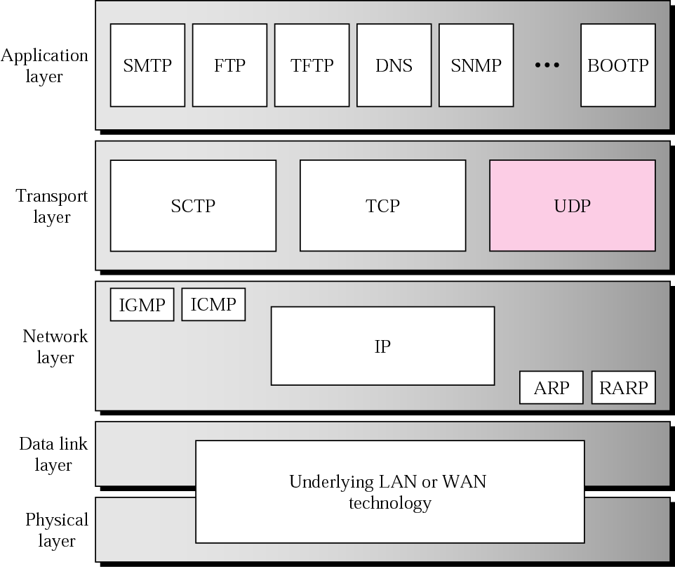
Position of UDP in the TCP/IP protocol suite

Slide 3
UDP
UDP is a connectionless and unreliable transport protocol.
It does not support segmentation and reassembly.
UDP is a simple protocol with minimum overhead.
Thus, if a process wants to send small message and does not care much about reliability, it uses UDP.
Sending a small message using UDP takes much less interaction between the sender and the receiver than using TCP.

Slide 4
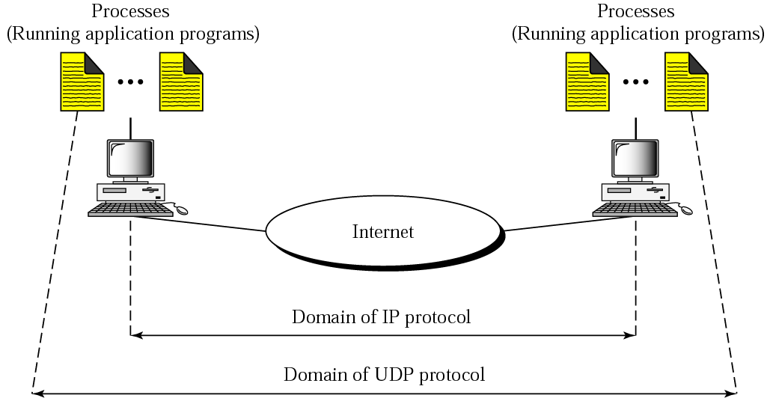
Process-to-Process Communication

Slide 5
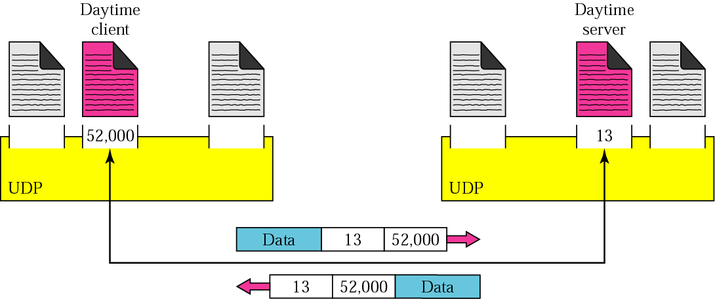
Port Numbers
Ephemeral Port Numbers

Slide 6
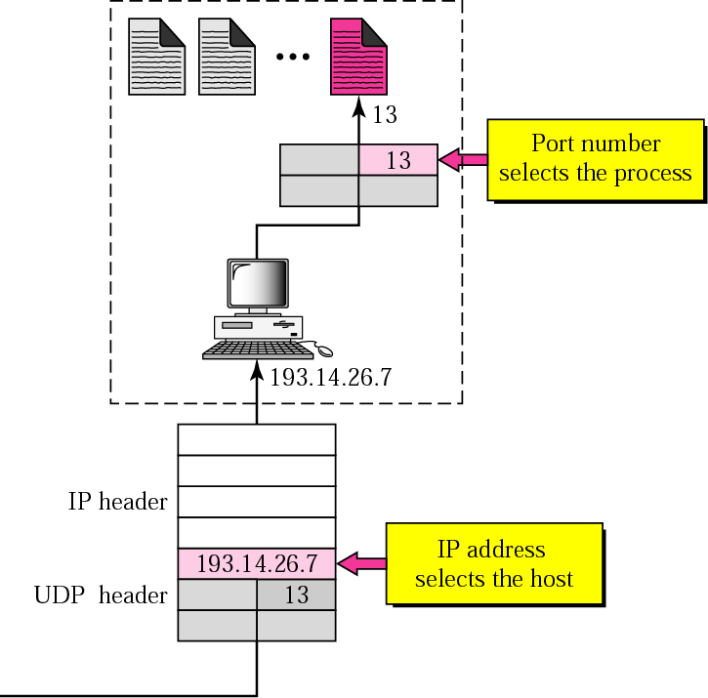
IP addresses versus port numbers

Slide 7
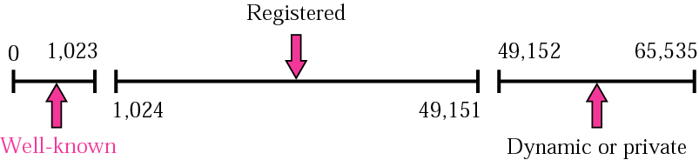
ICANN Port Number Ranges
The well-known port numbers are less than 1024.

Slide 8
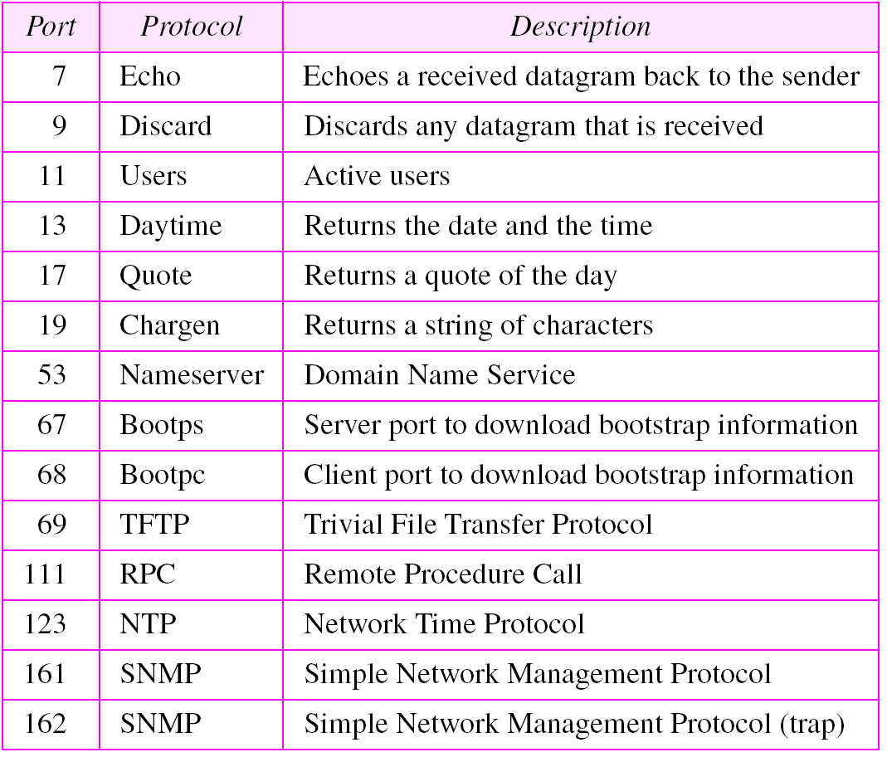
Well-known Ports used with UDP

Slide 9
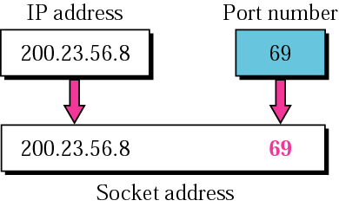
Socket Address
The combination of an IP address and Port number is called a socket address.
The client socket address defines the client process and server socket address defines the server process.
72
72

Slide 10
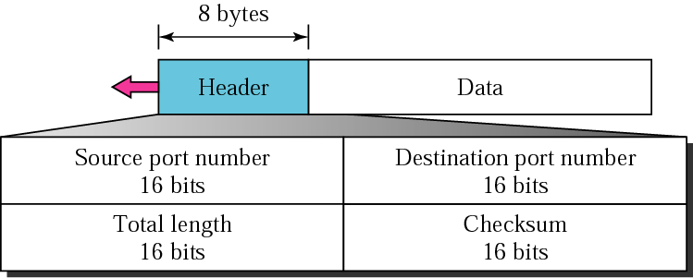
User Datagram
UDP packets are called user datagrams and have a fixed-size header of 8 bytes.
UDP length = IP length − IP header’s length

Slide 11
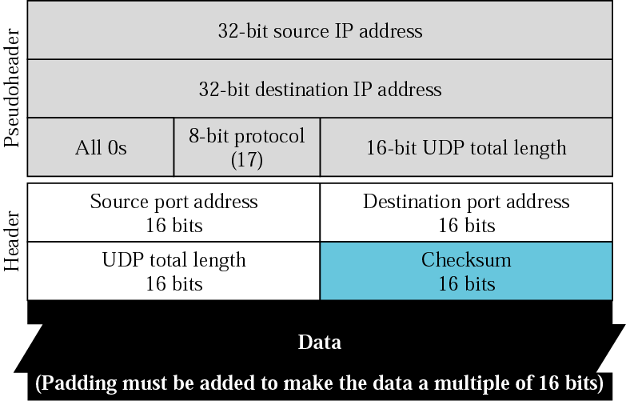
Checksum
UDP checksum calculation is different from the one for IP and ICMP.
Here the checksum includes three sections:
A pseudo-header,
The UDP header, and
The data coming from AL.
Pseudo-header
for checksum calculation

Slide 12
Questions
The following is a dump of a UDP header in hexadecimal form: 06 32 00 0D 00 1C E2 17
What is the: (a) Source port number (b) Destination port number
(c) Total length of the UDP (d) Length of the data
2. What is the maximum number of bytes that can be accommodated as UDP payload?

Slide 13
Questions
A client uses UDP to send data to a server. The data are 16 bytes. Calculate the efﬁciency of this transmission at the UDP level .
Redo the same question for calculating the efﬁciency of transmission at the IP level using IP.

Slide 14
UDP Operation: Connectionless Service
Each user datagram sent by UDP is an independent datagram.
There is no relationship between the different user datagrams even if they are coming from the same source process and going to the same destination program.
The user datagrams are not numbered.
There is no connection establishment and no connection termination as is the case for TCP.
This means that each user datagram can travel on a different path.
Notes:
Ramifications?

Slide 15
UDP Operation: Flow and Error Control
There is no Flow Control mechanism in UDP.
There is no error control Mechanism in UDP except for Checksum.
This means that the sender does not know if a message has been lost or duplicated. When the receiver detects an error through the checksum, the user datagram is silently discarded.
Congestion Control: UDP Operation?

Slide 16
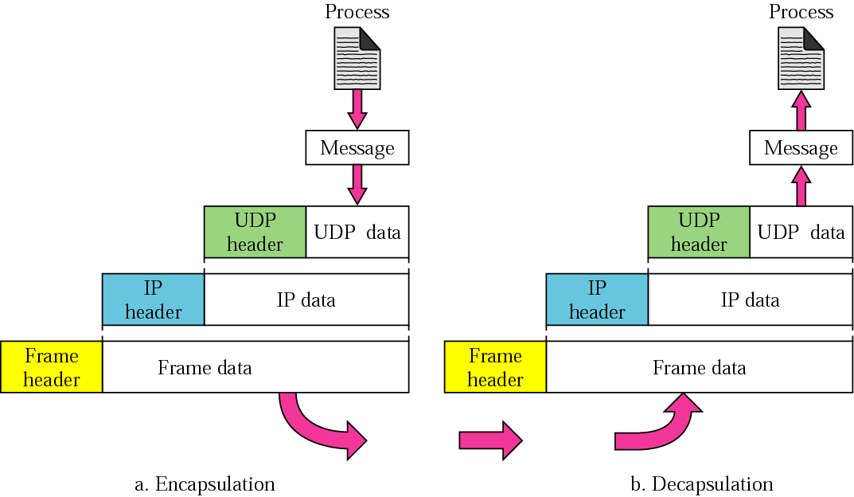
UDP Operation: Encapsulation and Decapsulation

Slide 17
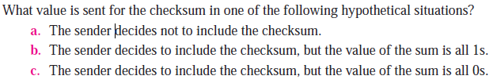
Question

Slide 18
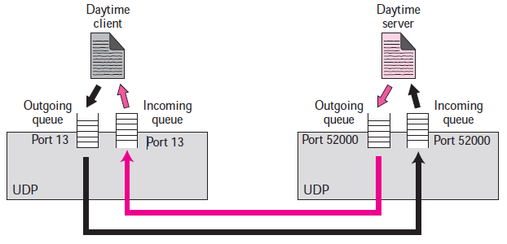
Queueing
Request a port number from the operating system.
One incoming and outgoing queue per process.
Process terminates, queues are destroyed.
Arrival of messages and queueing
Overflow: incoming queue and outgoing queue

Slide 19
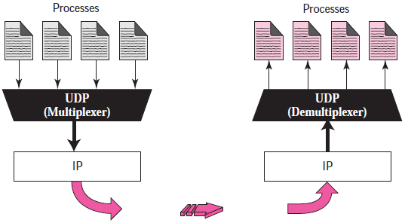
Multiplexing and Demultiplexing

Slide 20
Applications/Uses of UDP
UDP is suitable for a process that requires simple request-response communication with little concern for flow and error control. It is not usually used for a process such as FTP that needs to send bulk data.
UDP is suitable for a process with internal flow and error-control mechanisms, like TFTP.
UDP is a suitable transport protocol for multicasting. Multicasting capability is embedded in the UDP software but not in the TCP software.
UDP is used for management processes such as SNMP.
UDP is used for some route updating protocols such as RIP.
UDP is normally used for real-time applications that cannot tolerate uneven delay between sections of a received message.

Slide 21
2
C
A
1
2
5
3
D
F
1
B
3
2
4
E

